Slide 1
InfoSystem
MONITORAMENTO
DE HARDWARE

Slide 2



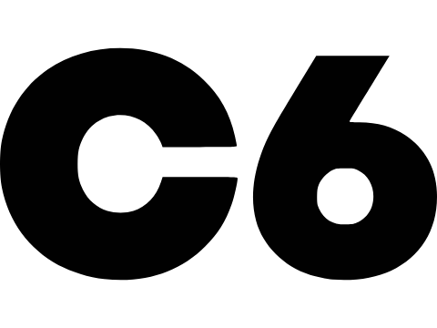
NOSSA EQUIPE
Guilherme Fonseca
Guilherme Almeida
Henri Cauã
Mateus Araujo
Mateus Ferreira
Vitoria da Silva

Slide 3
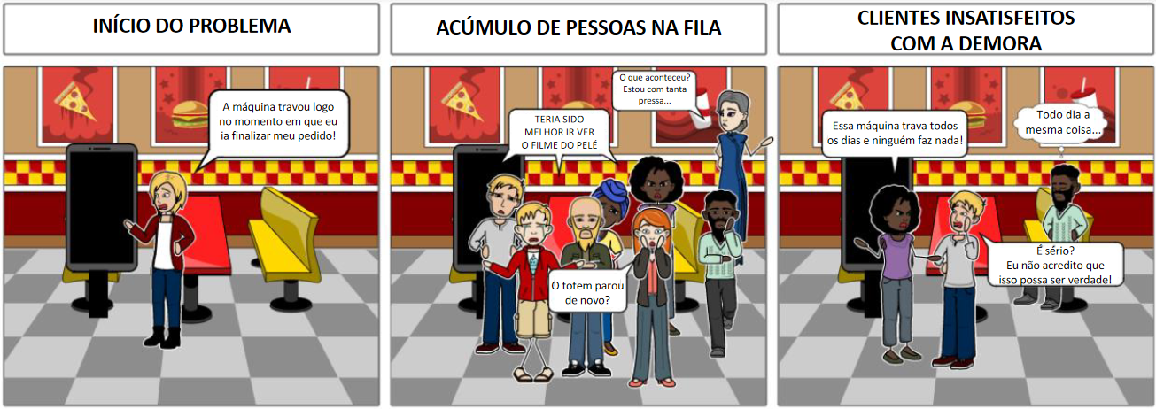
STORYBOARD 1/3

Slide 4
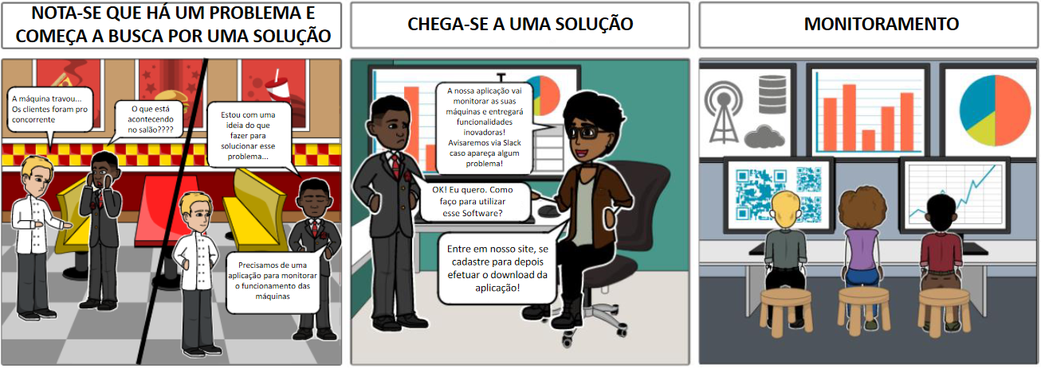
STORYBOARD 2/3

Slide 5
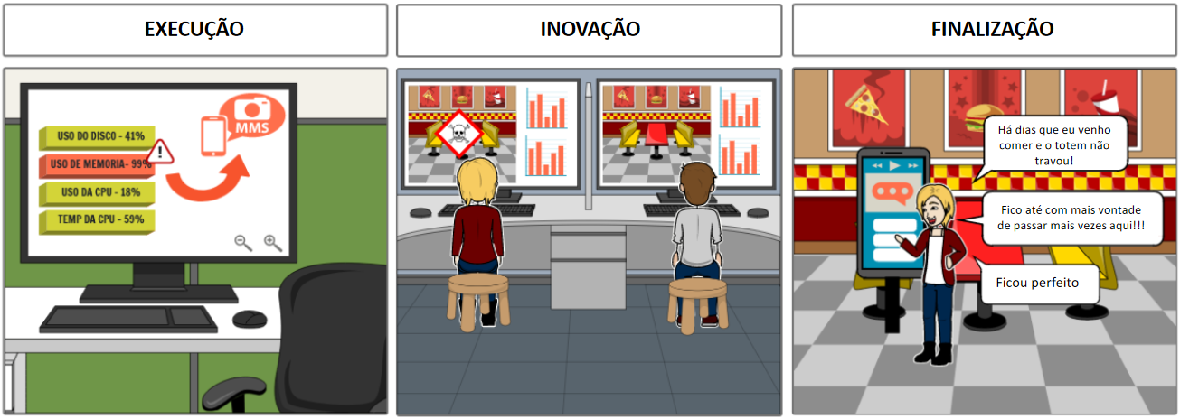
STORYBOARD 3/3

Slide 6

Persona
Quem? Marcelo
Informações/ Comportamento
Atarefado
Ágil
Conhecimento técnico em suporte de TI
Individualista
Perfil analítico
Jovem
“Eu sou um analista de suporte e gostaria de auxilio na gestão de monitoramento das minhas máquinas”
Dores e Necessidades
Dificuldade na solução
Falta de informações sobre o problema
Estresse
Falta de ferramentas e Infraestrutura
Tempo
Comunicação

Slide 7

(NOME DA NOSSA ALPICAÇÃO)
Monitoramento de Hardware
em Tempo Real!

Slide 8




















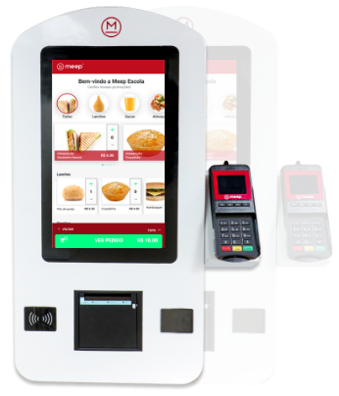
HLD

Slide 9
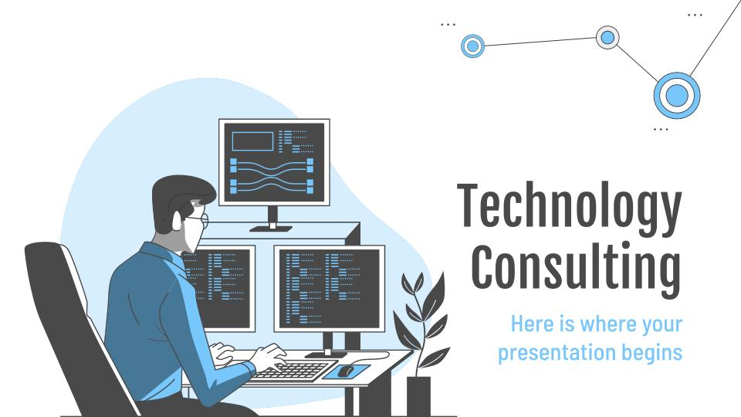
SITE INSTITUCIONAL

Slide 10
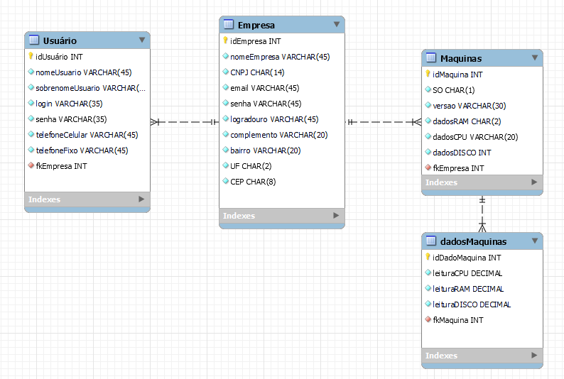
Modelo Lógido do Banco de Dados

Slide 11
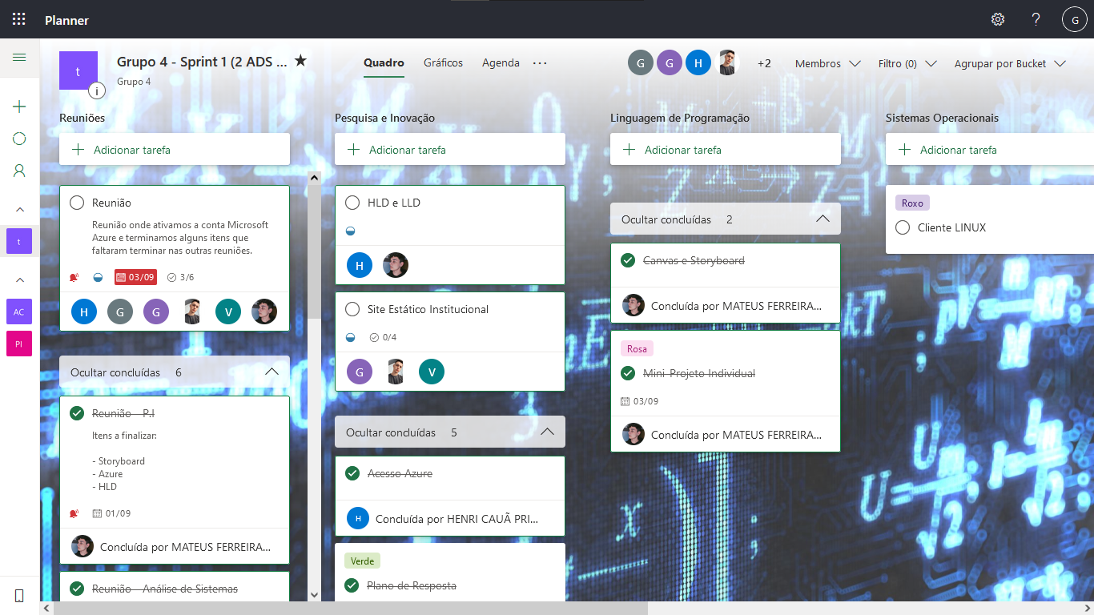
Ferramenta de Gestão
$20K
10%
45K

Slide 12
GitHub
$20K
10%
45K

Slide 13

—Someone Famous
“This is a quote, words full of wisdom that someone important said and can make the reader get inspired.”

Slide 14
Awesome Words

Slide 15
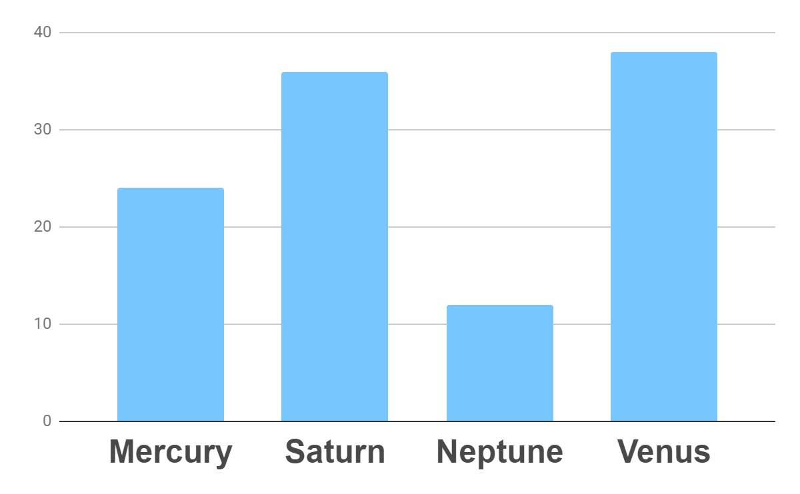
Analysis
Outreach
Top Rated Values
To modify this graph, click on it, follow the link, change the data and paste the new graph here

Slide 16
333,000.00
24h 37m 23s
386,000 km
earths is the sun’s mass
is Jupiter’s rotation period
is the distance to the Moon

Slide 17
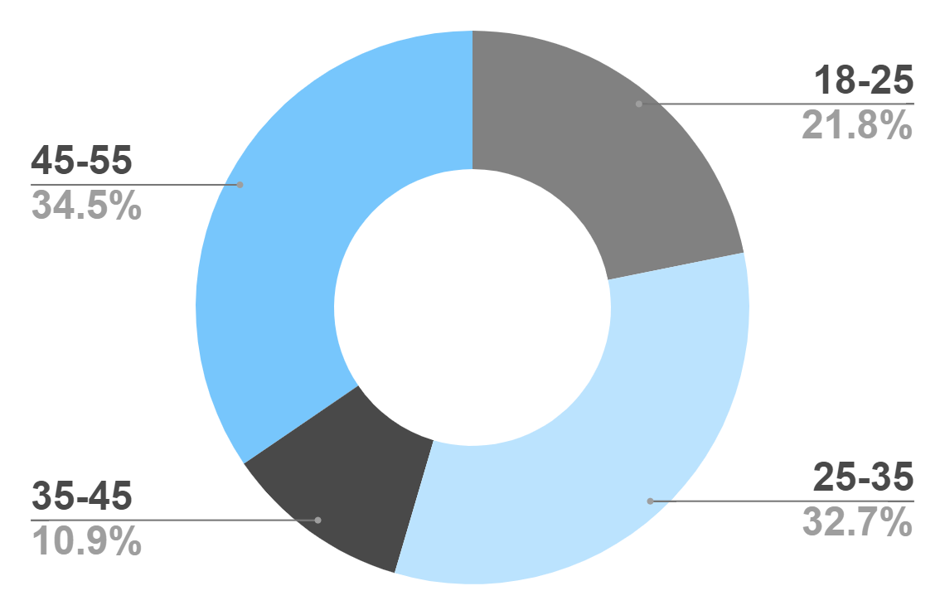
Target
Age
Gender
30%
70%
Interests
Security
Usability
To modify this graph, click on it, follow the link, change the data and paste the new graph here
Interface

Slide 18
Our Process
Mercury is the closest planet to the Sun
Venus is the second planet from the Sun
Day 1
Day 2
Day 3
Day 4
Jupiter is the biggest planet in the Solar System
Neptune is the farthest planet from the Sun

Slide 19
Whoa!
This could be the part of the presentation where you can introduce yourself, write your email…

Slide 20
Our Consultants
John James
Venus is the second planet from the Sun
Jane Patterson
Joe Doe
Mercury is the closest planet to the Sun
Neptune is the farthest planet from the Sun

Slide 21
Our Partners
Mercury
Jupiter
Neptune
Mercury is the closest planet to the Sun
Jupiter is the biggest planet of them all
Neptune is the farthest planet from the Sun
Saturn
Mars
Venus
Saturn is the ringed one and a gas giant
Despite being red, Mars is actually a cold place
Venus is the second planet from the Sun

Slide 22
Testimonials
Helena James
“Mercury is the closest planet to the Sun”
Jenna Doe
“Jupiter is the biggest planet of them all “
Mary Patterson
“Neptune is the farthest planet from the Sun”

Slide 23
Awards
Mercury
It’s the closest planet to the Sun
Venus
Venus is the second planet from the Sun
Jupiter
Jupiter is the biggest planet of them all

Slide 24
498,300,000
Big numbers catch your audience’s attention

Slide 25
Upcoming Goals
January
February
March
April
Goal 1
Phase 1
Phase 2

Slide 26
The Slide Title Goes Here!
Do you know what helps you make your point clear? Lists like this one:
They’re simple
You can organize your ideas clearly
You’ll never forget to buy milk!
And the most important thing: the audience won’t miss the point of your
presentation

Slide 27

A Picture Is Worth a Thousand Words

Slide 28
Infographics Make Your Idea
Understandable…
Mercury
Neptune
Mercury is the closest planet to the Sun
Neptune is the farthest planet from the Sun
Jupiter
Saturn
Jupiter is the biggest planet of them all
Saturn is the ringed one and a gas giant

Slide 29
…And the Same Goes for Tables
 | Mass (earths) | Diameter (earths) | Gravity (earths)
Mercury | 0.06 | 0.38 | 0.38
Mars | 0.11 | 0.53 | 0.38
Saturn | 95.2 | 9.4 | 1.16

Slide 30
Maybe You Need to Divide the Content
01
02
Neptune
Jupiter
Neptune is the farthest planet from the Sun and the fourth-largest in the Solar System
Jupiter is the biggest planet in the Solar System and the fourth-brightest one

Slide 31
Thanks!
Do you have any questions?
youremail@freepik.com
+91 620 421 838
yourcompany.com
Please keep this slide for attribution

